Slide 1
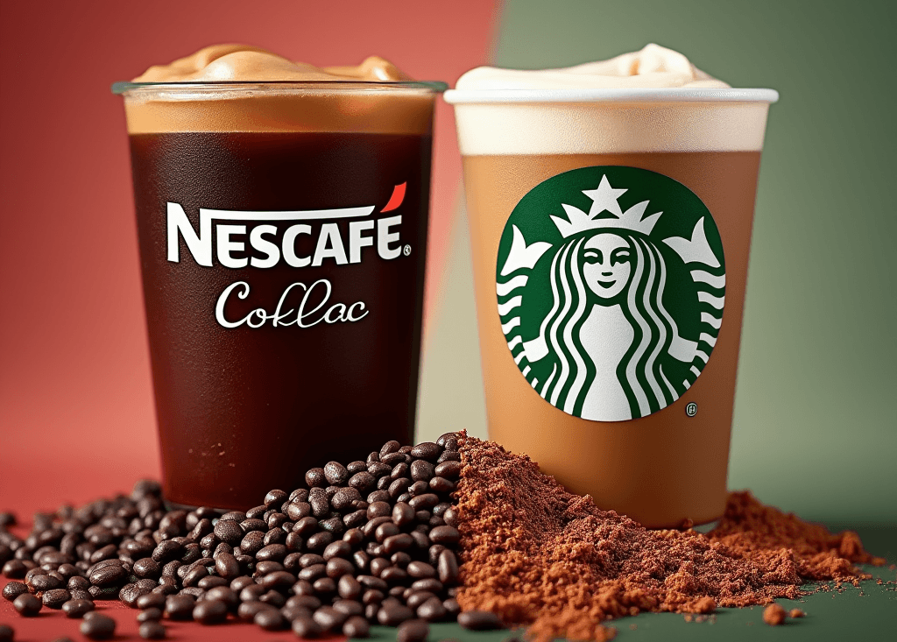
Coffee Sales Analysis
Nescafe vs Starbucks
Ashirwad B

Slide 2
Objective of the case
Objective
Nescafe's Goal: To gain a deeper understanding of their shoppers by analyzing consumer characteristics and preferences, and to compare them with Starbucks shoppers in order to enhance Nescafe’s product and marketing strategies.
Key Focus Areas:
Who are Nescafe's Buyers? Analyze demographics, psychographics, and lifestyle characteristics.
Who are Starbucks' Buyers? Compare with Nescafe to identify key differences.
Preferences: Examine shopping, product, and advertising preferences for both brands.
Strategic Insights: Identify opportunities for Nescafe to attract and capture Starbucks shoppers.

Slide 3
Urban Affluence and Lifestyle: Nescafe shoppers include a significant urban middle class, while Starbucks targets the urban and suburban affluent.
Health and Wellness Activity Levels: Nescafe shoppers are 23.3% very active and in managing their health, while Starbucks shoppers show slightly higher health activity, with 20.8% very active.
Hobbies: Both groups enjoy cooking, baking, and DIY projects, but Starbucks shoppers are more inclined toward outdoor activities such as running, skiing, and yoga/pilates.
Age and Employment: Both Nescafe and Starbucks shoppers are concentrated in the 25-44 age range and predominantly full-time employed, with Starbucks having slightly older customers overall.
Income: Nescafe shoppers are more middle-income (under $80k), while Starbucks attracts a higher percentage of affluent consumers (33.5% earn over $125k).
Education: Starbucks shoppers are generally more educated, with a higher percentage holding college and graduate degrees compared to Nescafe shoppers.
Marital Status and Household Size: Both groups have a high percentage of married individuals and 2-4 member households, though Starbucks has slightly more 2-person households.

Slide 5
Advertising Preferences: Nescafe shoppers prefer traditional media (TV, in-store promotions), while Starbucks shoppers are influenced by digital channels (online web, mobile, social media).
Shopping Behavior: Nescafe shoppers are more budget- and value-driven, using coupons and making shopping lists, whereas Starbucks shoppers are more quality- and status-driven, enjoying trying new products.
Online Shopping: Nescafe shoppers prefer physical stores, while Starbucks shoppers find online shopping very convenient and enjoyable.
Health and Wellness: Nescafe shoppers follow health trends but are less focused on active health management, while Starbucks shoppers are more health-conscious, regularly checking nutrition labels and staying active.

Slide 6
Key Differences Between Nescafe and Starbucks Shoppers
Demographics: Nescafe shoppers have a broader income range and diverse educational backgrounds, while Starbucks shoppers typically have higher incomes and more advanced degrees.
Psychographics: Nescafe shoppers prioritize convenience and quality and are often busy, whereas Starbucks shoppers are health-conscious and seek premium experiences.
Advertising and Shopping Behavior: Nescafe shoppers respond more to traditional advertising channels (TV, in-store, print), while Starbucks shoppers are influenced by digital channels (online, mobile, social media).
Lifestyle: Nescafe shoppers exhibit a varied lifestyle with a mix of urban and suburban dwellers, whereas Starbucks shoppers tend to be more urban affluent.

Slide 7
Strategies for Nescafe to Attract Starbucks Shoppers
Emphasize Quality and Premium Experience: Highlight the quality of Nescafe products and introduce premium options to appeal to the health-conscious Starbucks audience.
Digital Marketing: Increase online presence through social media, mobile, and web advertising to effectively reach Starbucks shoppers.
Health and Wellness: Develop products with sustainable and recyclable packaging to attract health-conscious consumers, emphasizing these features in marketing campaigns.
In-Store Experience: Enhance the in-store experience to reflect a more premium feel, including improved layouts, engaging customer service, and diverse coffee offerings.
Targeted Advertising: Utilize targeted advertising on platforms like Amazon or Google Ads to effectively reach the specific demographics and psychographics of Starbucks shoppers.

